Slide 1



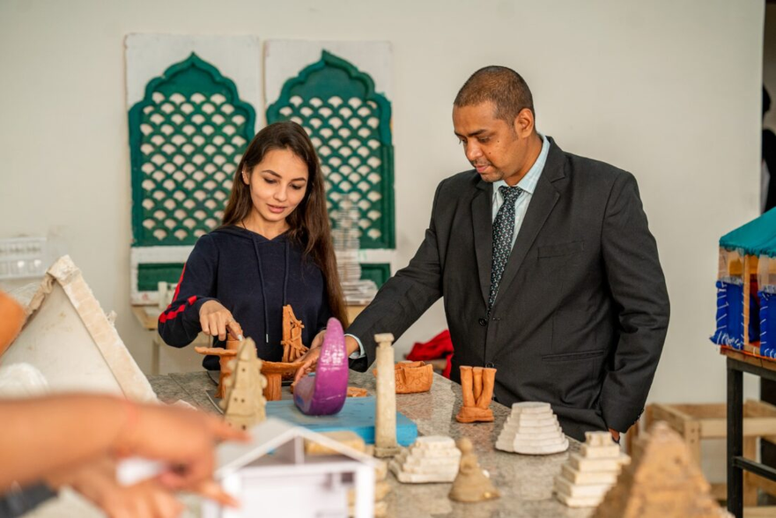
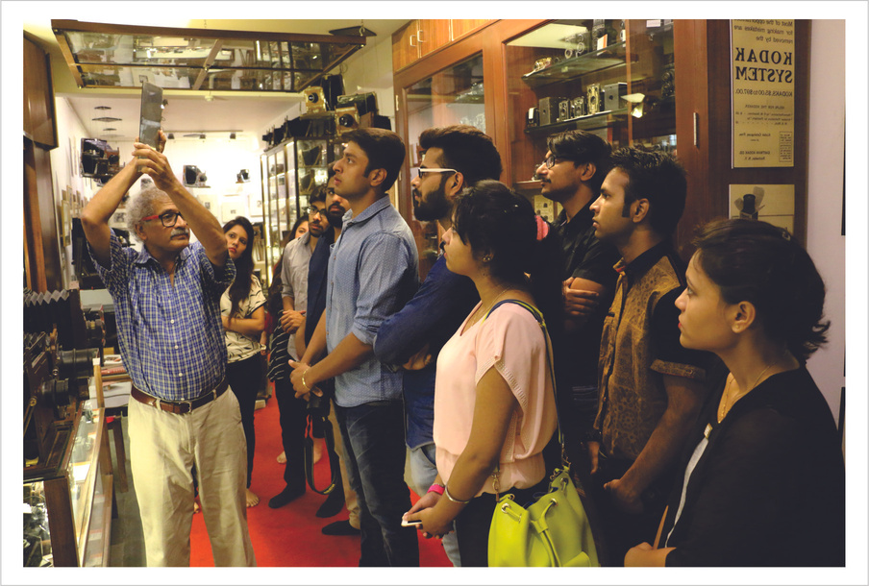
STUDENT -CENTRIC PEDAGOGY: ENGAGING LEARNING MINDS THROUGH PARTICIPATORY AND EXPERIENTIAL LEARNING
Institutional Distinctiveness

Slide 2
OBJECTIVE
METHODOLOGY
INDEX PAGE
THE PRACTICE
OUTCOME

Slide 3
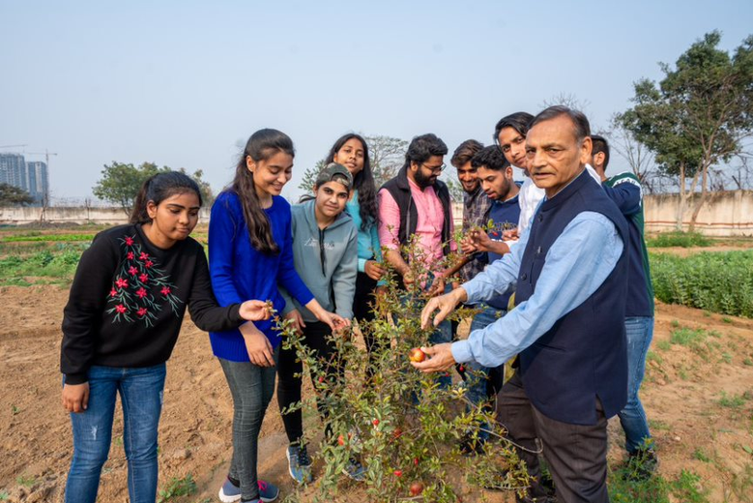
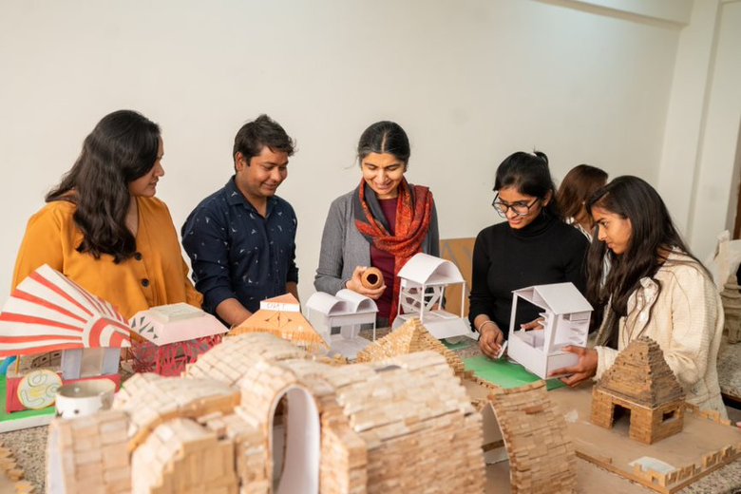

About
Institutional Distinctiveness is aligned with university mission for preparing them to foster employability ,entrepreneurship, lifelong learning, innovative thinking. Preparing for global needs and enhancing leadership qualities.
Student-centric pedagogy places learners at the core of the educational process, emphasizing active participation and experiential learning. By incorporating activities like teamwork, quizzes, debates, and field visits, project work, it bridges the gap between theory and practice, fostering critical thinking, problem-solving, and communication skills.
Learner’s Development
  Cognitive Domain
  Affective Domain
  Psychomotor Domain

Slide 4

OBJECTIVES
To train teachers to know the learning domains
To create Learner Interest in Healthy Learning Environment
To Bridge the Gap Between Theory and Practical
More empowerment of students to be independent and Intra Dependent
To choose between Participatory and Experimental Learning
1
2
3
4
5

Slide 5
The Process
Analyzing
  Analyzing the curriculum.​
Identification
  Identification of courses in the Curriculum for Experiential and Participative learning by each school
Planning
  Devising of the Experiential Learning Calendar for School ,Cubs ,Societies ,YRC & NSS. Auditing and Finalization of the ELC
Implementation
  Activities are conducted by the Schools, Clubs & Societies, NSS and Red-Cross as per devised Experiential Learning Calendar.
Outcome
Students are evaluated through formative and summative assessment. Credits given for project work, internships and in Internal Assessment.

Slide 6
Uniqueness of Experiential Learning Calendar
Alignment of Experiential Learning Calendar with Vision & Mission of University
Maximization of Curriculum Alignments with Experiential and Participative Learning ,working at granular level by aligning courses.
Involvement of Each stake holder for building a Student Centric Pedagogy –Students, Faculty, Alumni, Community, Industry Patterners ,Academia.
Dedicated involvement of Deans , IQAC ,Administration and Resources for planning, monitoring and execution by regular follow-up and audits
Reviewing of Documentation with respect to same as per the format and guidelines.
Aligning with the Sustainable Development Goals

Slide 7
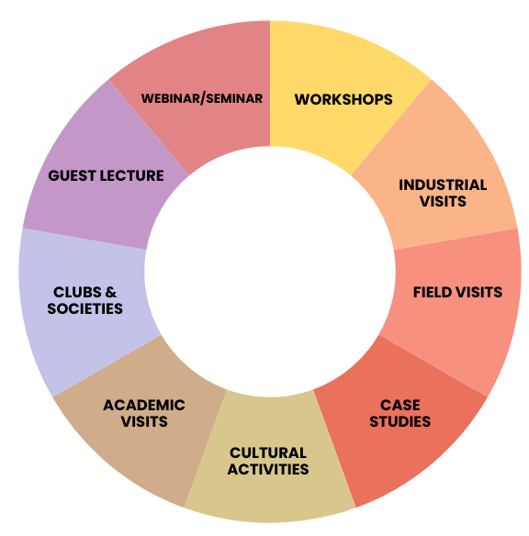
Methodology
Experiential Learning-Optimal learning is achieved through engaging all senses that further enhances overall development and retention of the knowledge for application and creation. To bridge the gap between theory and practice, experiential learning acts as a catalyst in developing skills.

Slide 8
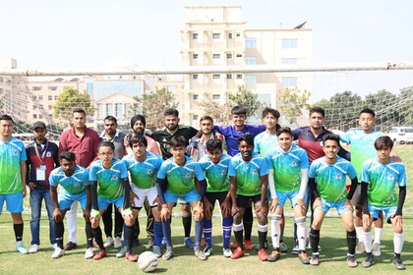
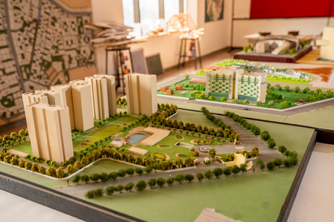

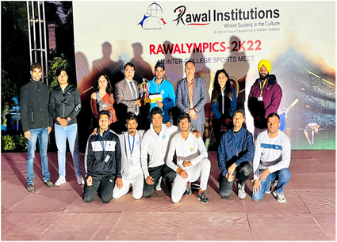
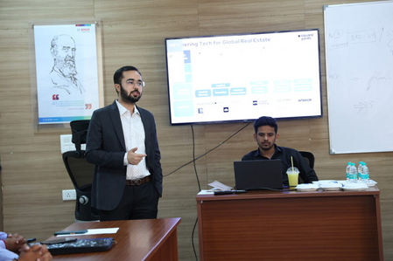
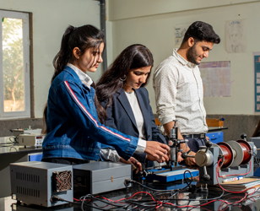
The Pedagogical Approach
Competition at University & Inter University Level
Projects based Learning to Develop Problem Solving Skills
Student led Clubs and Societies and Centers of Excellence
Seminars, Workshops, Sessions and Webinars to Encourage students Participation
Agricultural Activity like Organic Farming, Mushroom Farming, Vermicompost Making etc
Industrial, Education and Field Visit

Slide 9
Activities Conducted by Schools, Clubs, Societies & Centers
Year 2018-23
Category | No. of Events
Workshops , Seminar, Webinar, Guest Lectures, Talks | 605
Extension Activities | 124
Industrial/Academic Visits | 99
MoU Activities | 114
Case Studies | 10
Total | 952
Year 2023-24
Category | No. of Events
Workshops , Seminar, Webinar, Guest Lectures, Talks | 399
Extension Activities | 58
Industrial/Academic Visits | 69
MoU Activities | 72
Case Studies | 15
Total Activities | 613
124
114
609
99

Slide 10
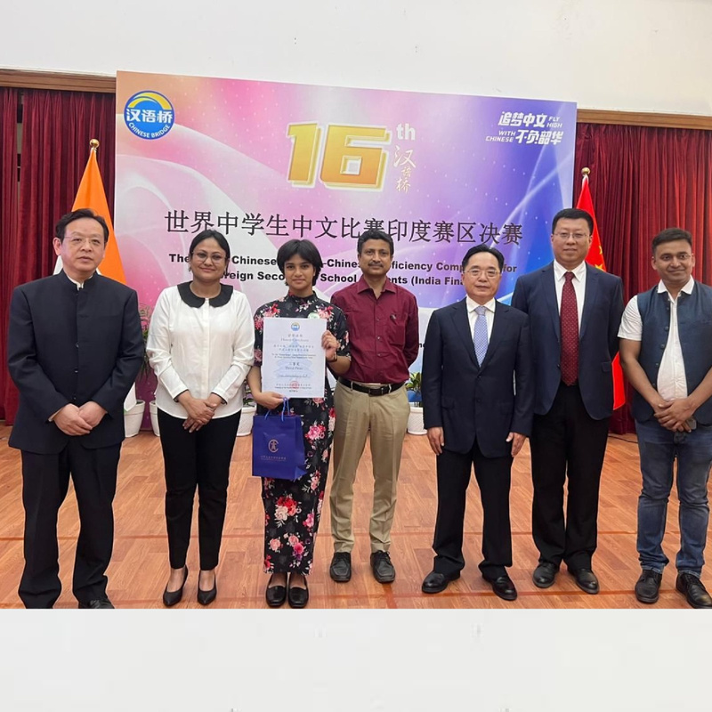
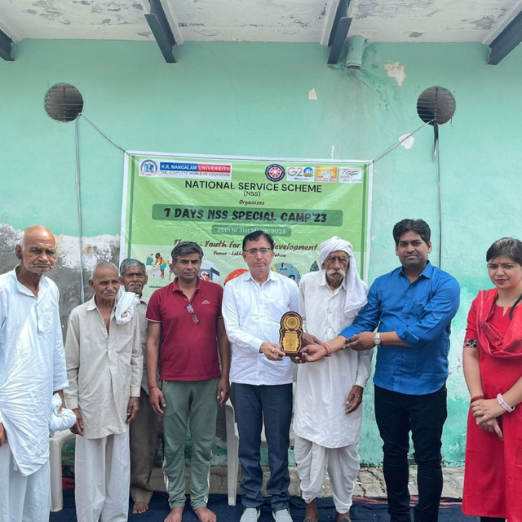
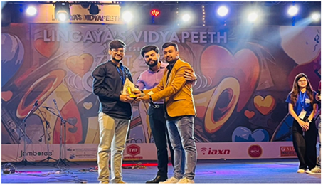
Benefits of Experiential and Participative Learning
Promoting active student involvement through diverse and engaging activities such as role plays, teamwork, debates, seminars, quizzes, field visits, project work under MoU, industrial tours, and guest lectures.
  Strengthening the skills and expertise of both students and faculty.
  Boosting student motivation and enthusiasm for learning.
  Providing a platform to challenge and engage advanced learners.
  Bridging the gap between theoretical knowledge and practical application.
  Cultivating problem-solving abilities and critical thinking skills.
  Enhancing communication skills and building confidence in public speaking and group presentations.

Slide 11
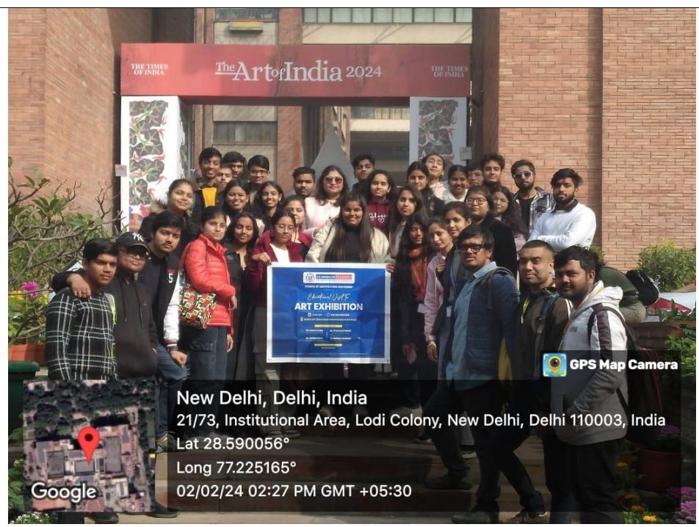
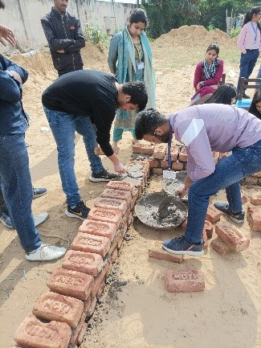
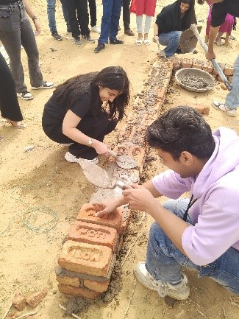
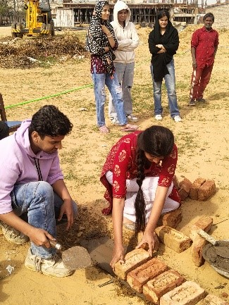
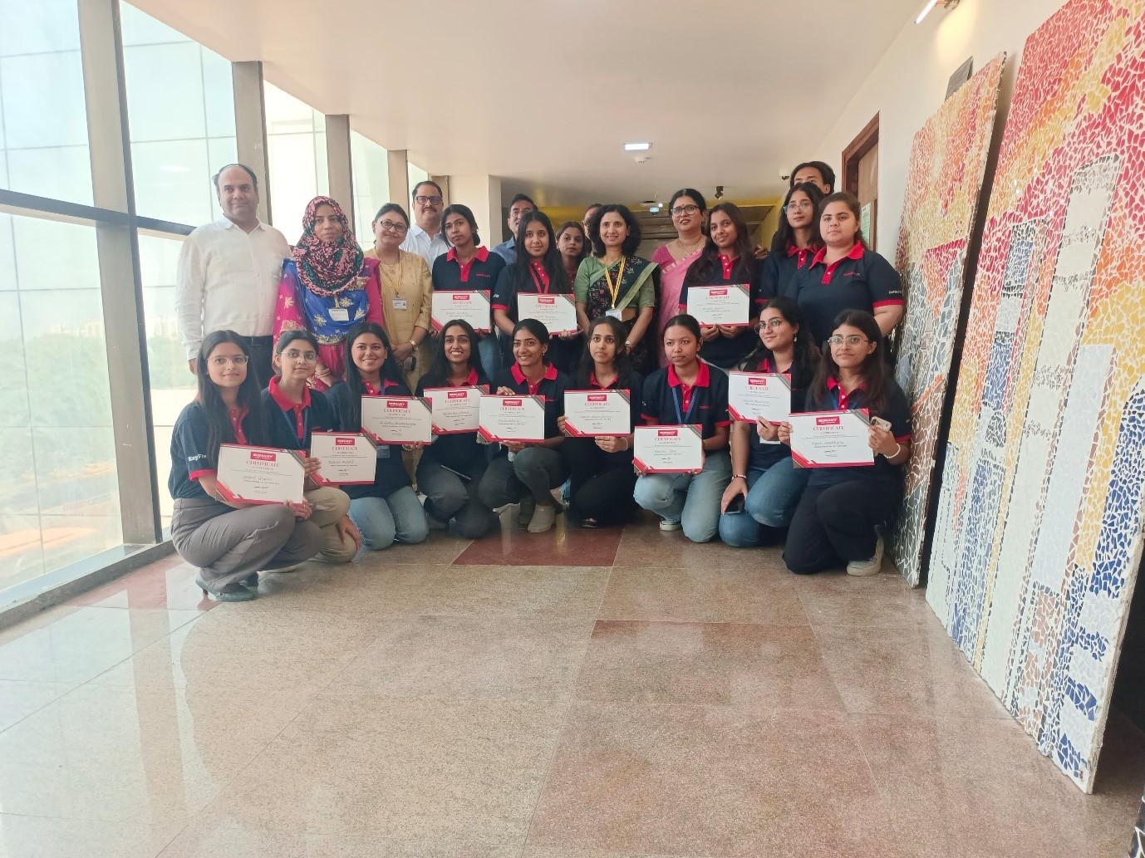
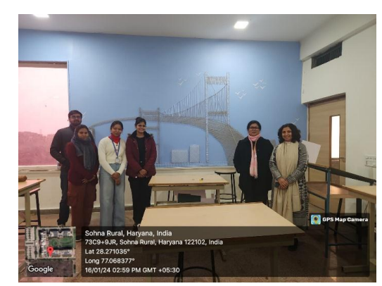
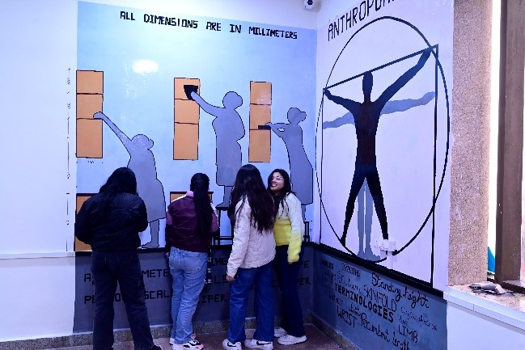
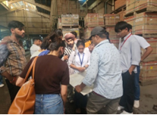
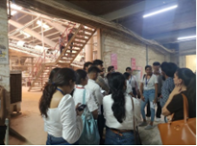
Experiential Learning in SOAD
Hands-on learning at KRMU Construction Yard
Ceramic tile art mural workshop
Visit to the Indian Habitat Centre
Studio Symphony
Industrial Visit to Somany Tiles factory
Wall Of Wonder: Design Edition

Slide 12
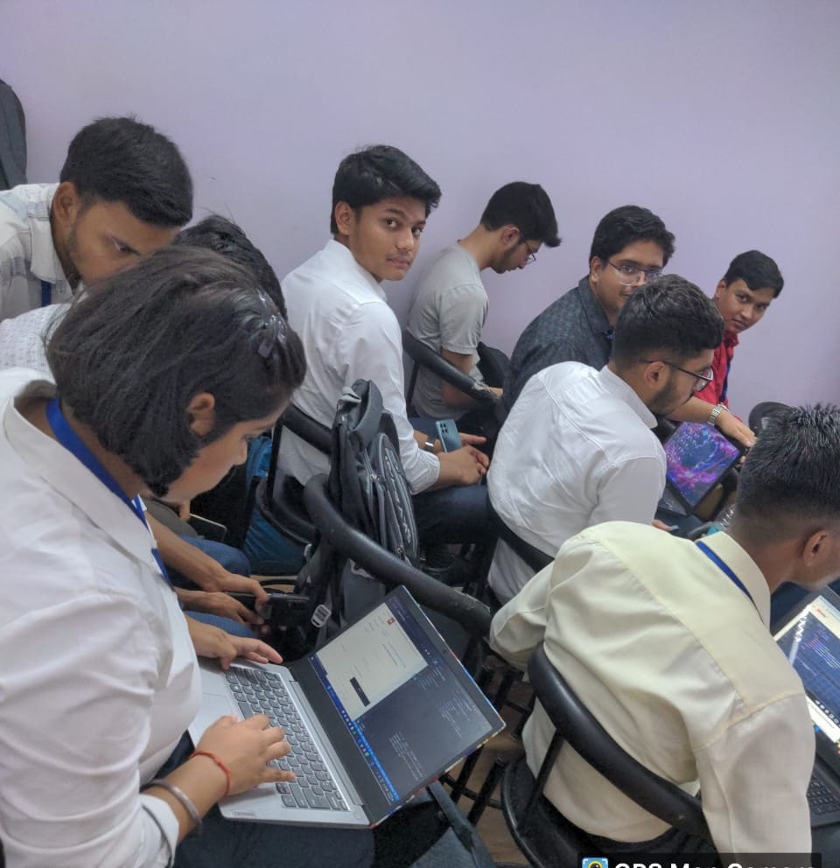
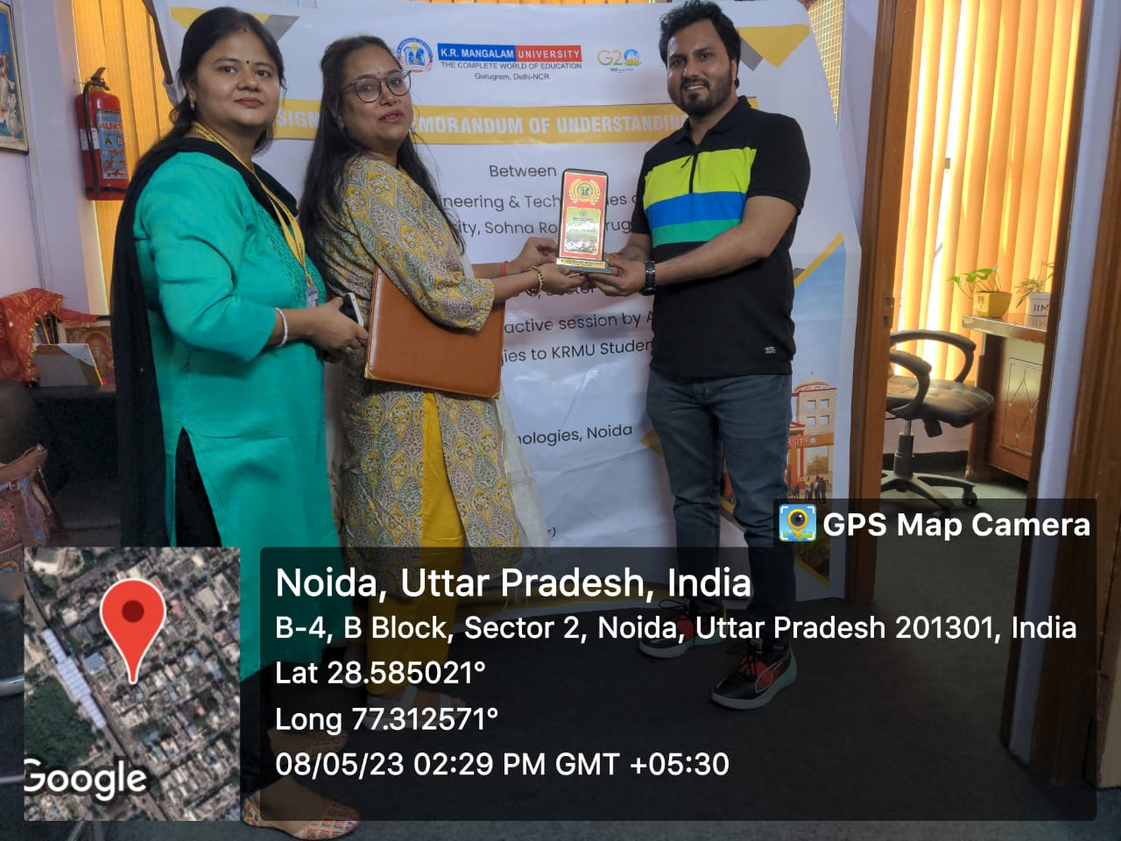
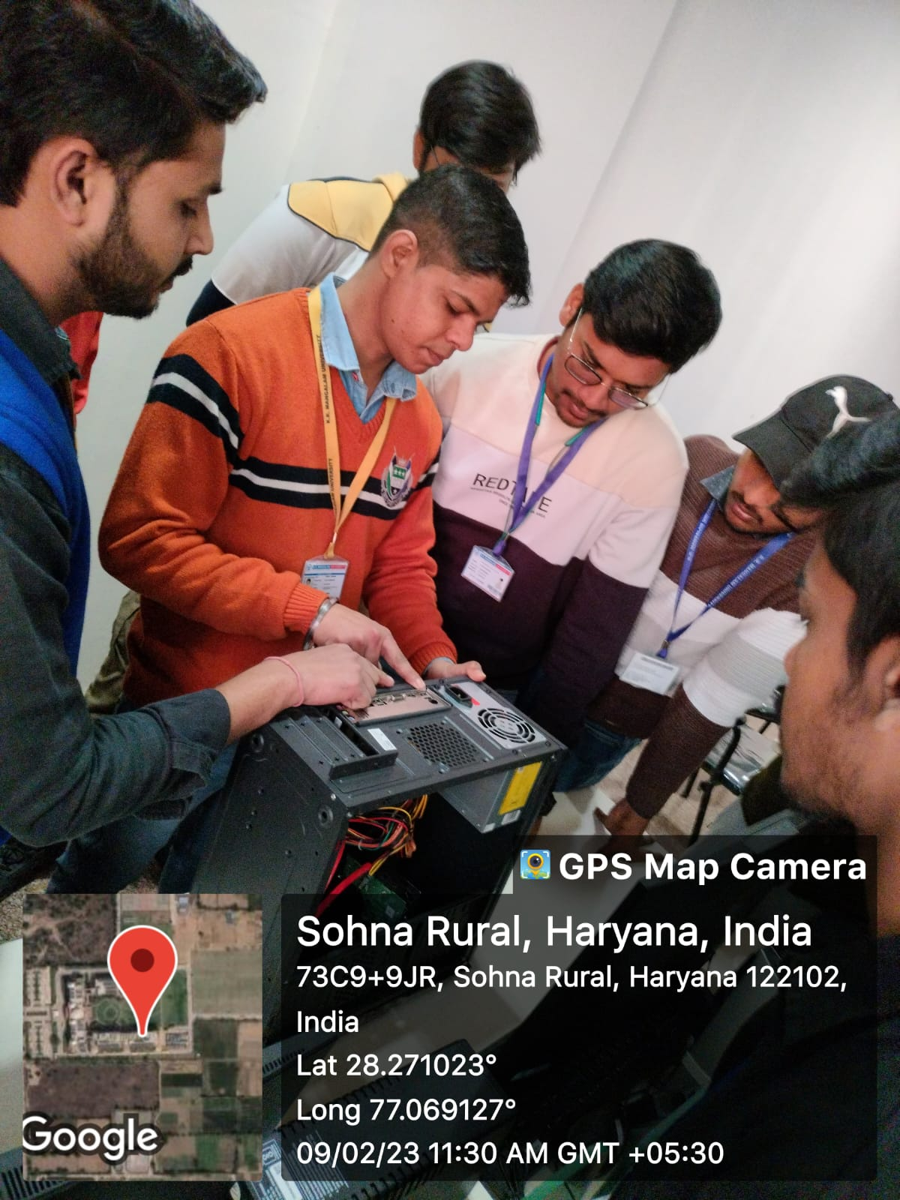
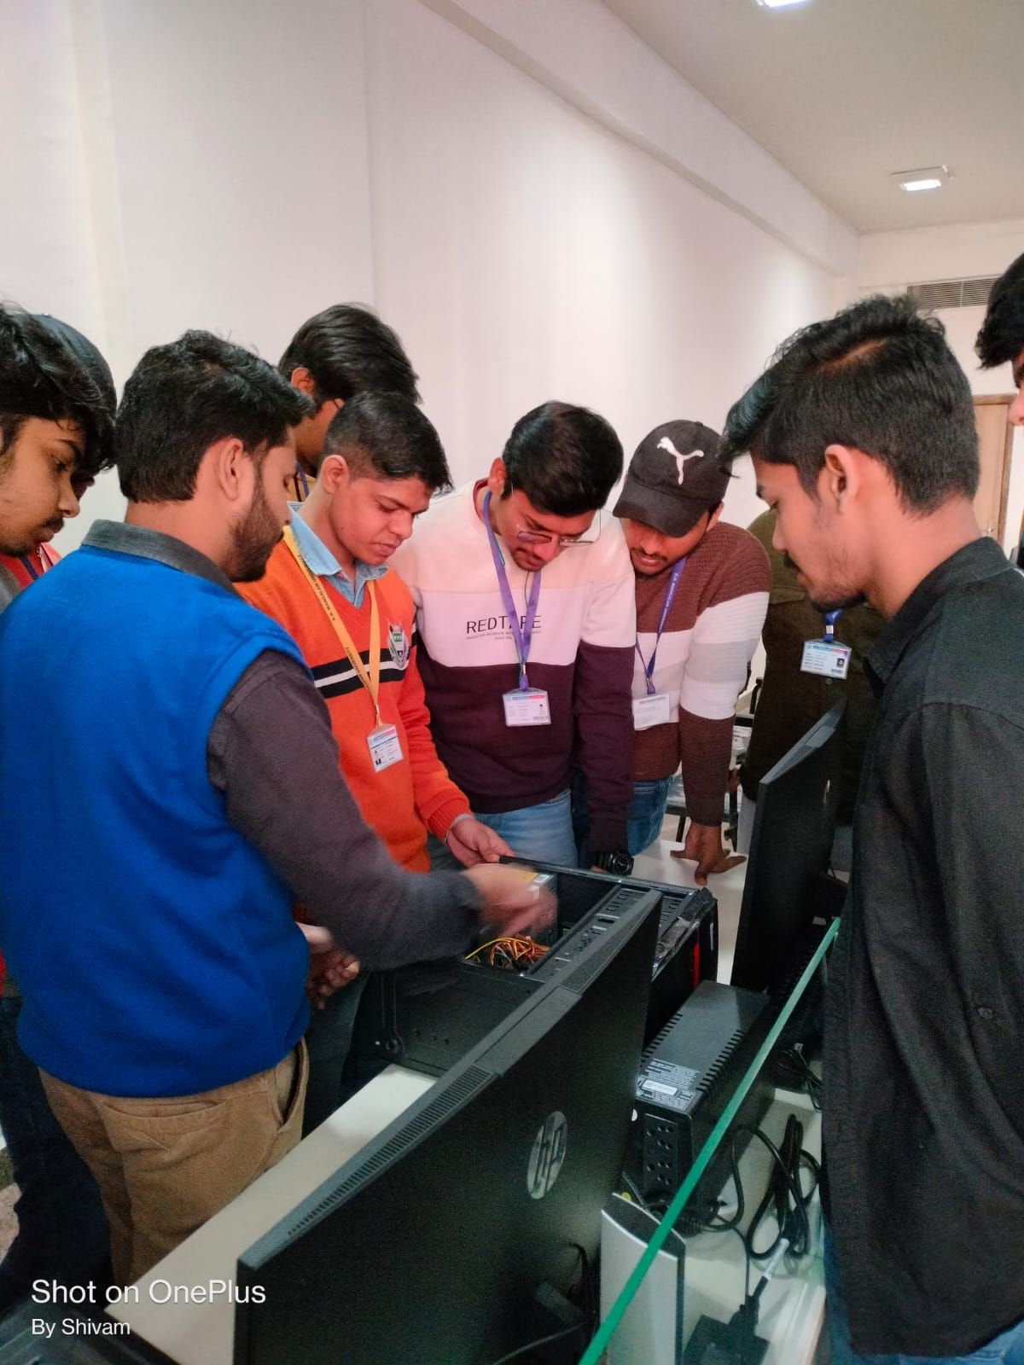
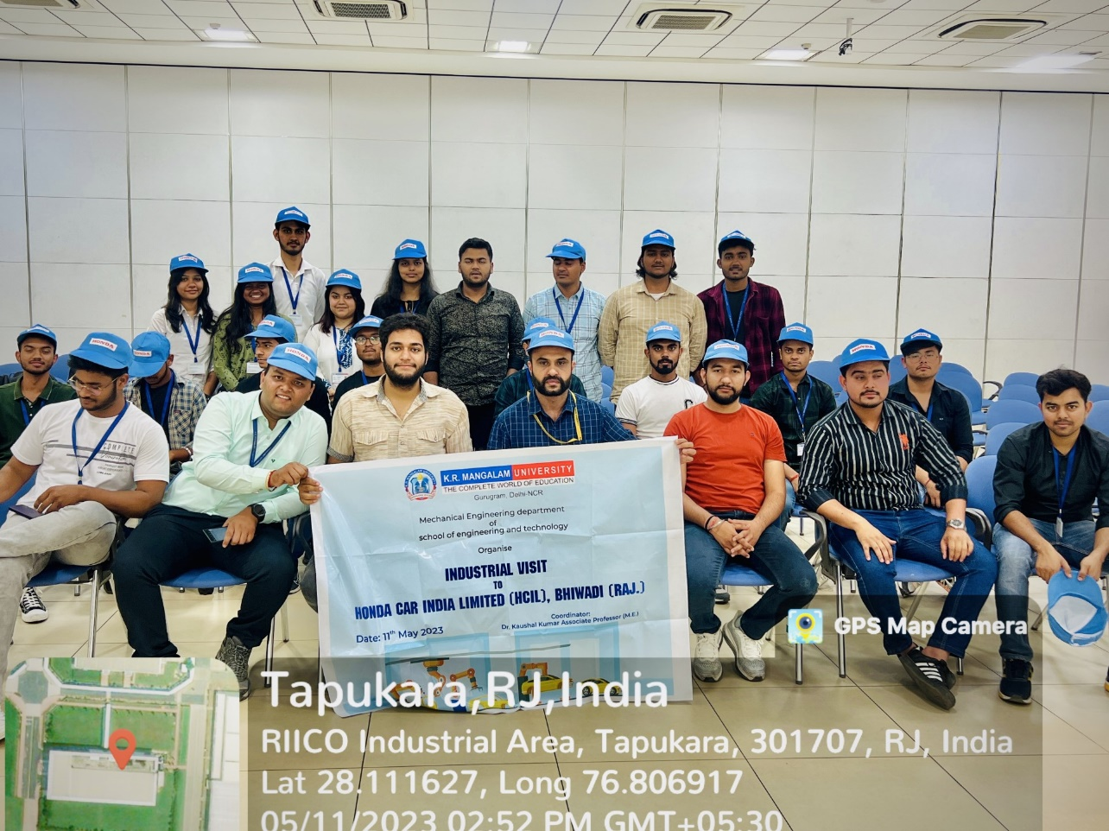
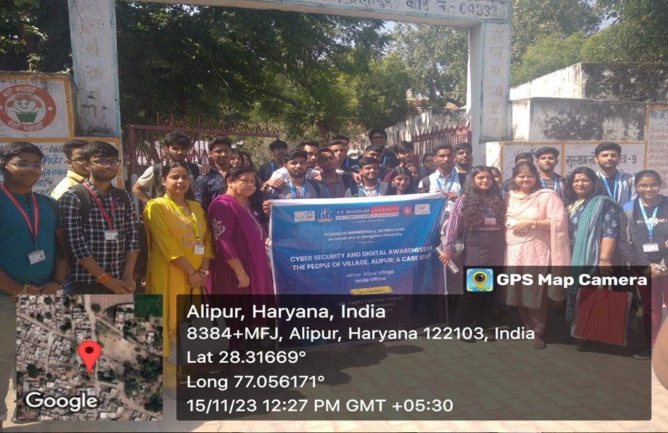
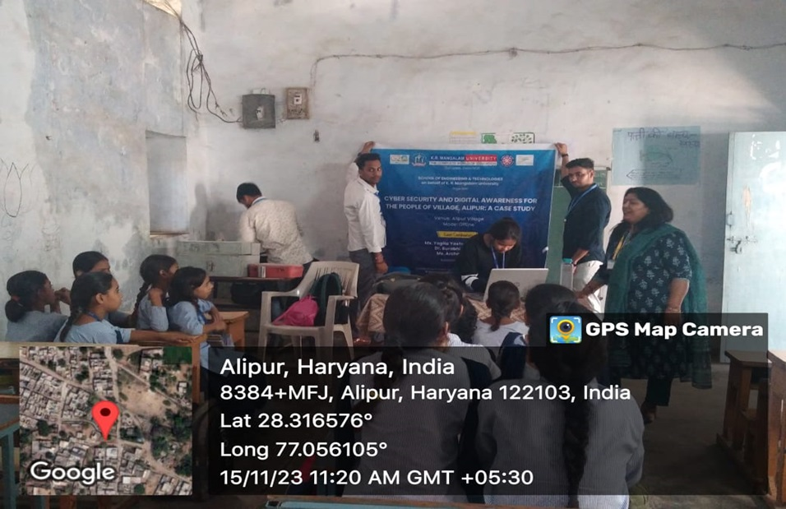
Experiential Learning in SOET
Field Projects on Digital Marketing (APPWARS Technologies Pvt Ltd)
Cyber security and digital awareness for the peoples of Village, Alipur: A case study.
Industrial Visit at Honda Cars India Pvt. Ltd. Bhiwadi
One day Workshop on Computer hardware Assembling

Slide 13
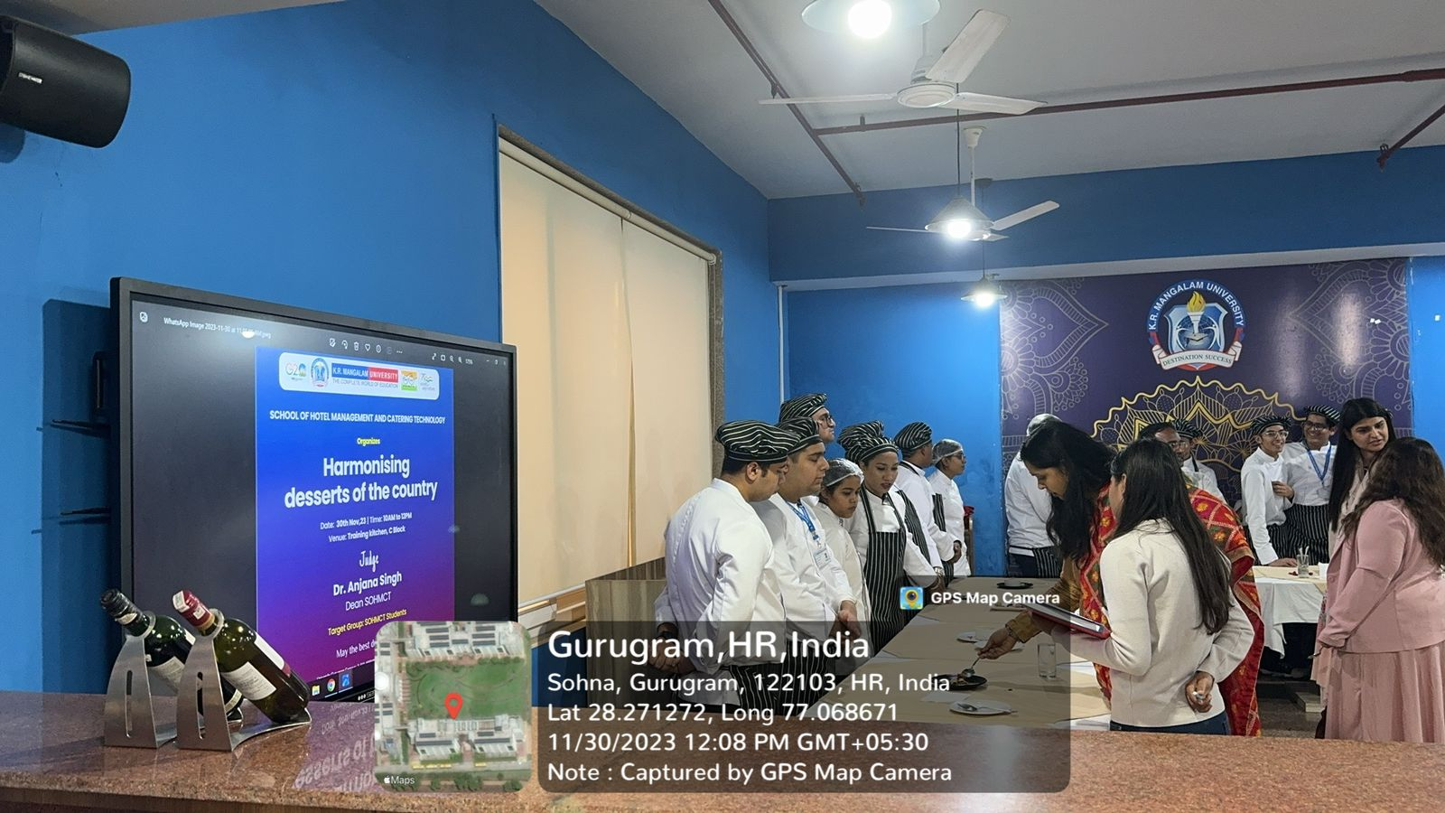
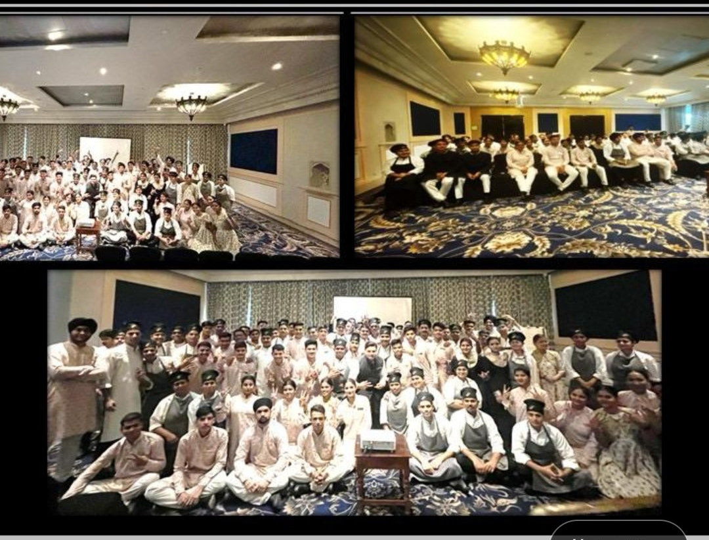
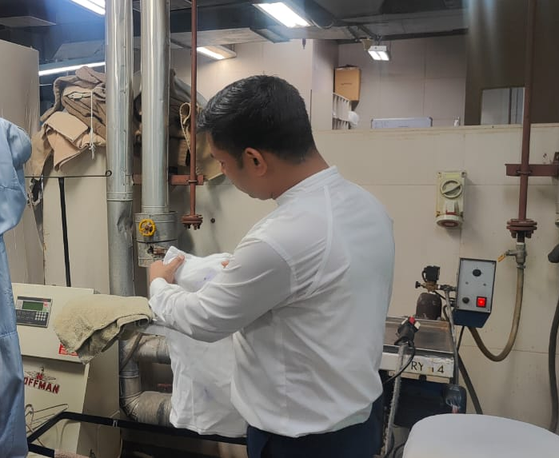
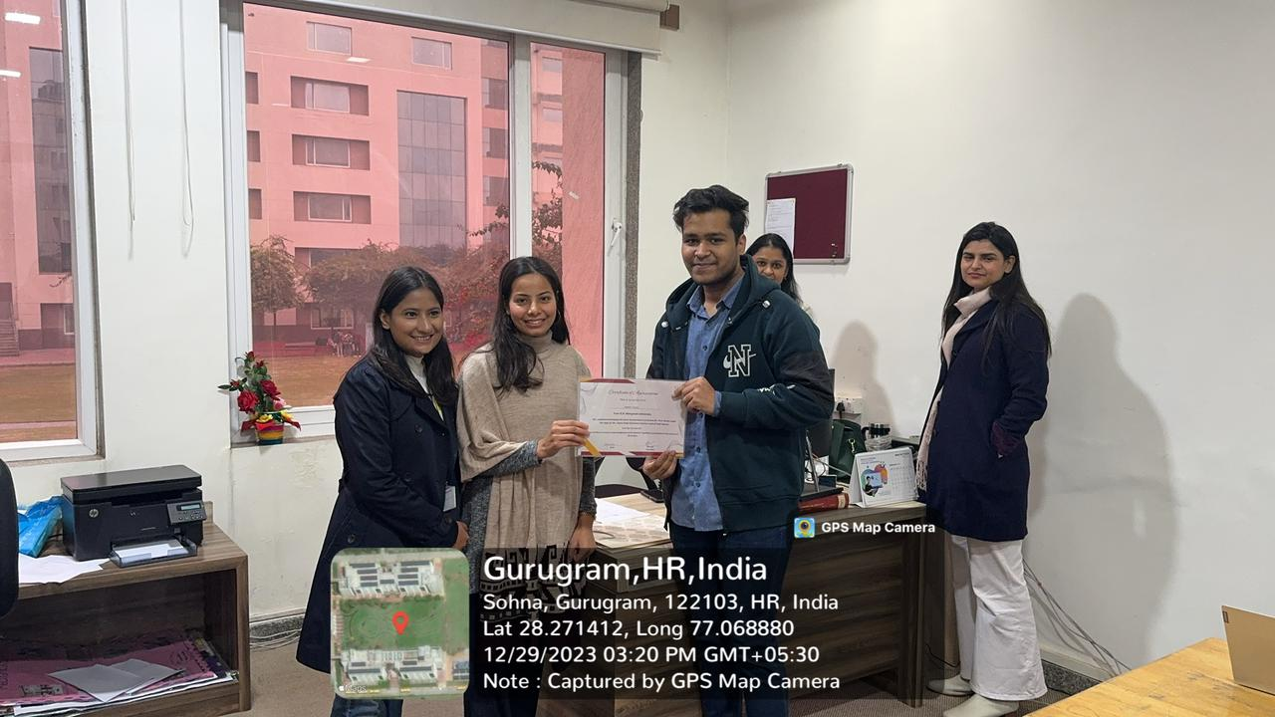
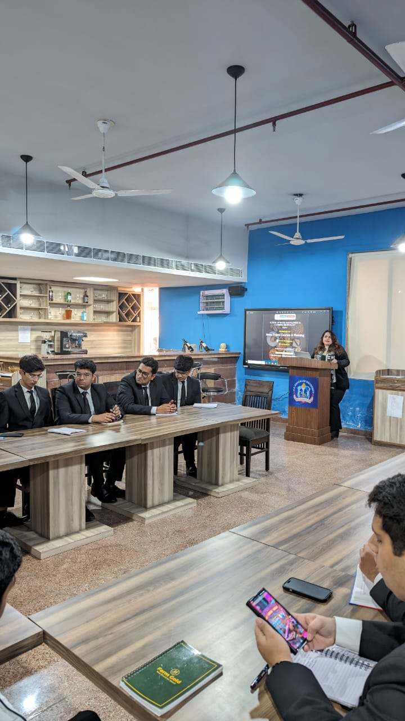
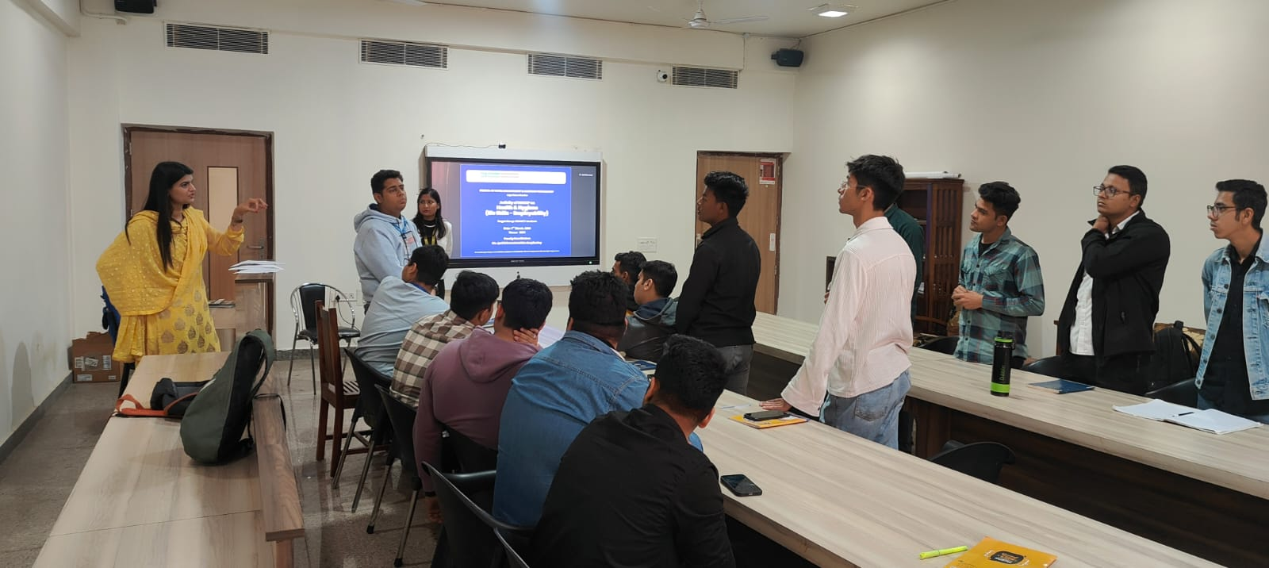
Experiential and Participative Learning in SOHMCT
Harmonizing desserts of the country
Project work (fairmont Jaipur) Project work part two: Working in a specific department
The Art Of Stain Removal and Flower Arrangement
Project work First new MOU (Posh Domo), Project work: Students will be designing the curriculum for the Jobs related to Housekeeping and Home Chef
Activity of HACCP on health and hygiene
Workshop on ""Menu Types: Courses & Planning"" (Life Skill -

Slide 14
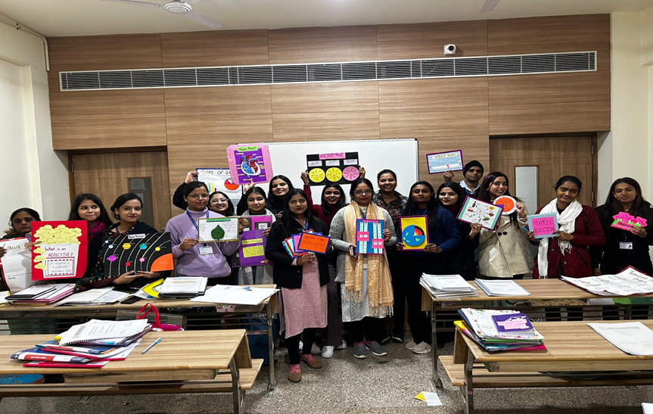
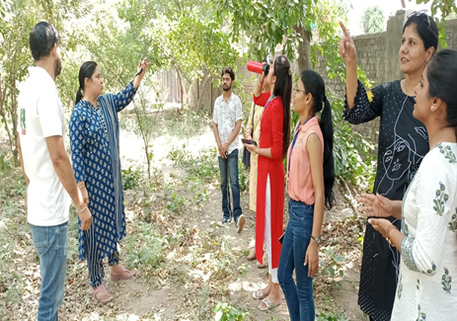
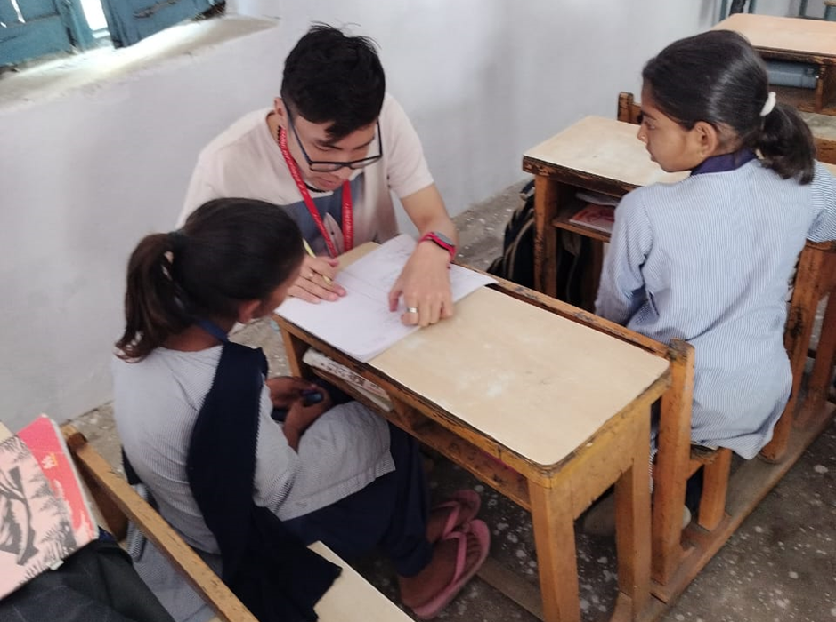
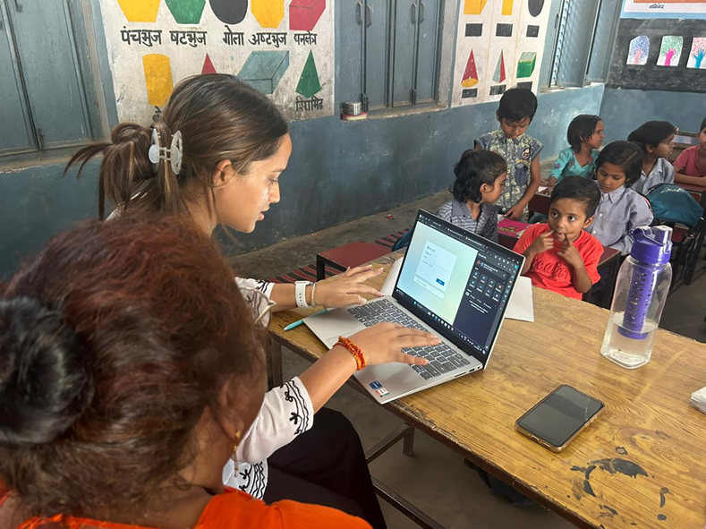
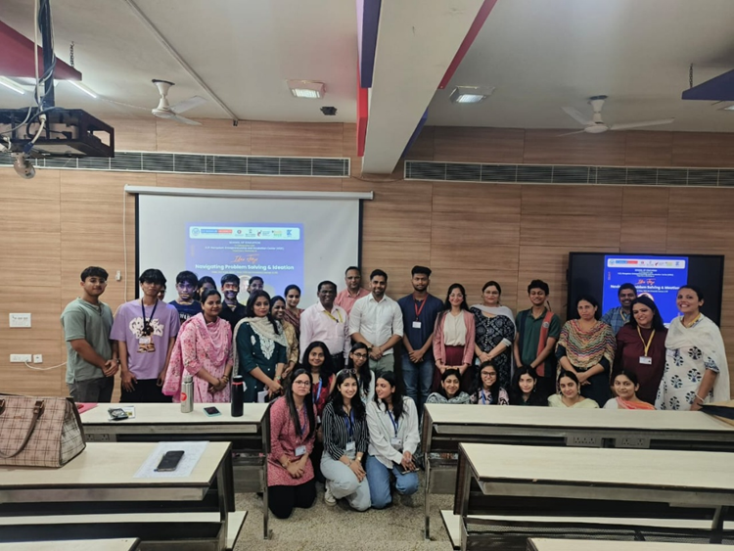
Experiential and Participative Learning in SOED
Students showcasing the props used in their storytelling and drama sessions
Volunteers from Save Aravali Trust explaining the procedure of Wastewater Management to the student-teachers
Student teachers engage students with different activities and make learning a joyful experience while teaching at school
Student-teacher detailing the various features of Gmail to the teachers of the school
      A Workshop on Idea Forge: Navigating Problem Solving and Ideation

Slide 15
Assessment
Students are provided marks in formative/Internal assessment.
Credits also provided to students for internships, project work etc. in the curriculum.
1
2
From 2024-25, One credit from participation in co-curricular activities like Club/Society activities that contribute to their personal development, leadership skills, and community engagement.
Under the category of Club/Society, 1 credit can be earned by registration in one of the Club/Societies of university and active participation in the events organized by the club/society OR
15 hours of active engagement in any of the recreational/sports activities

Slide 16
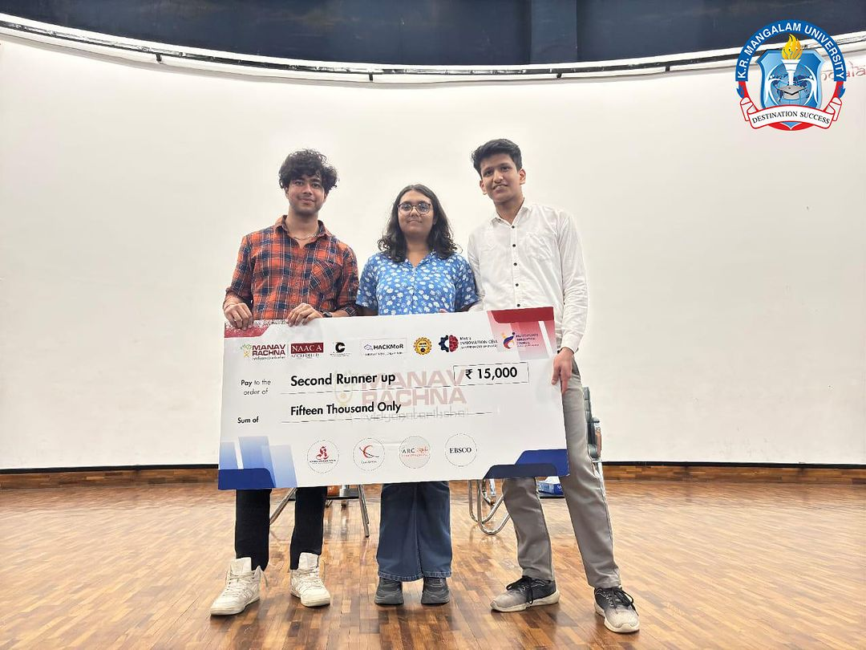
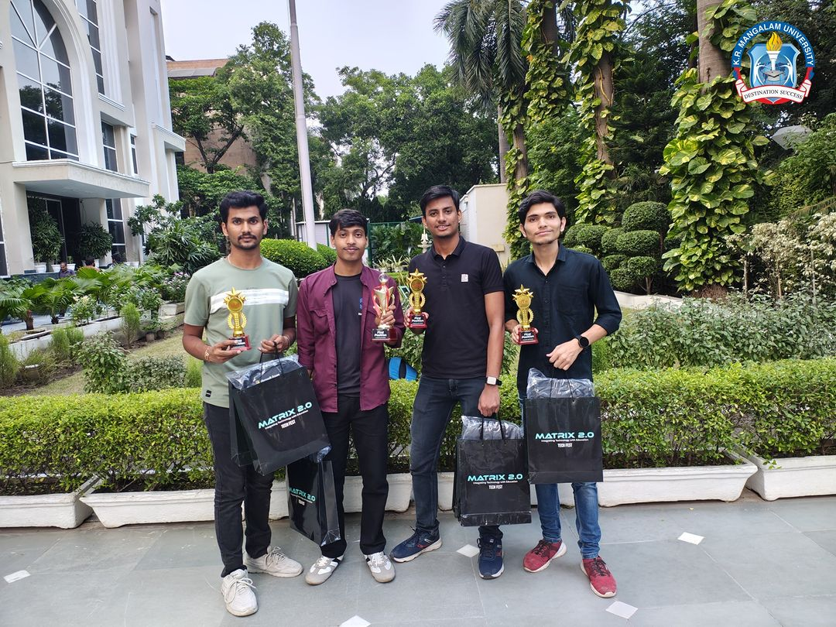
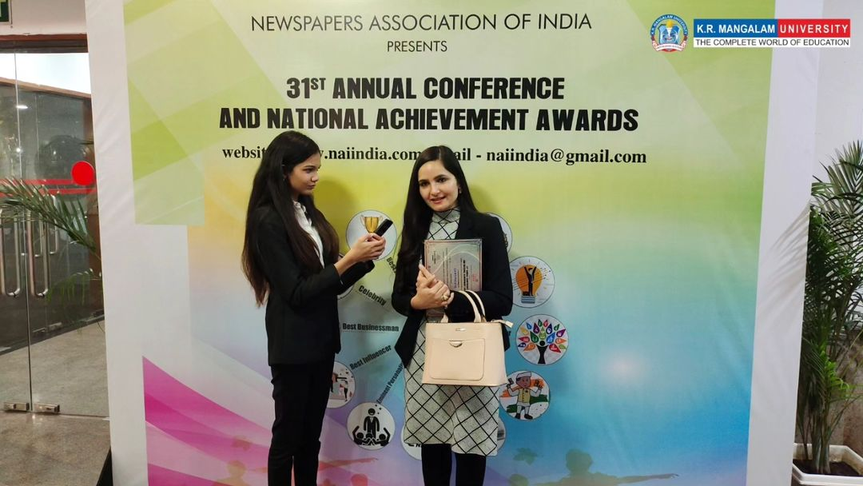
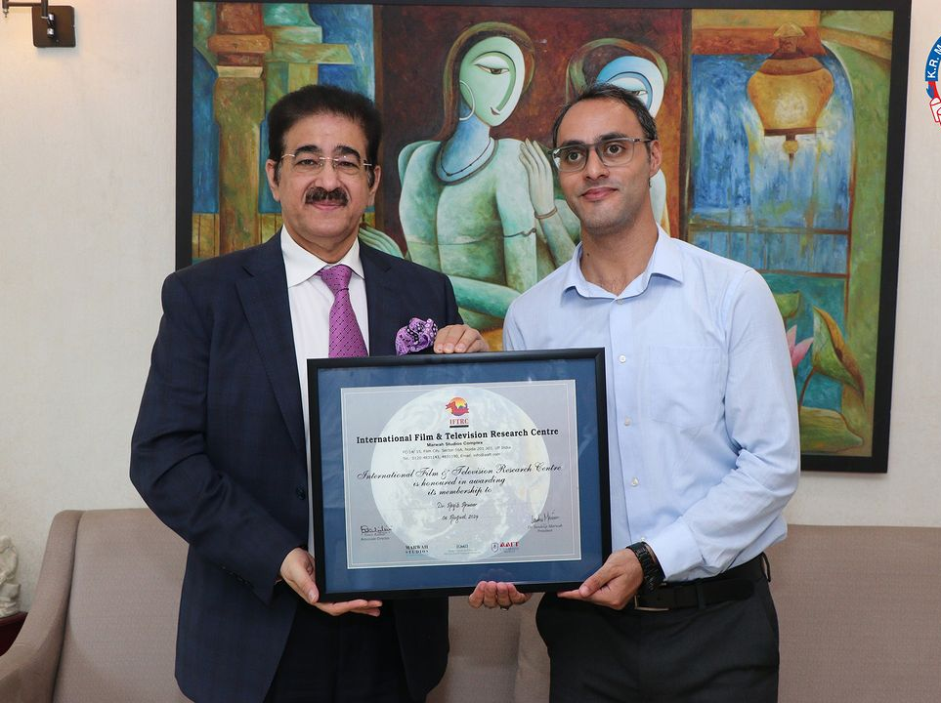
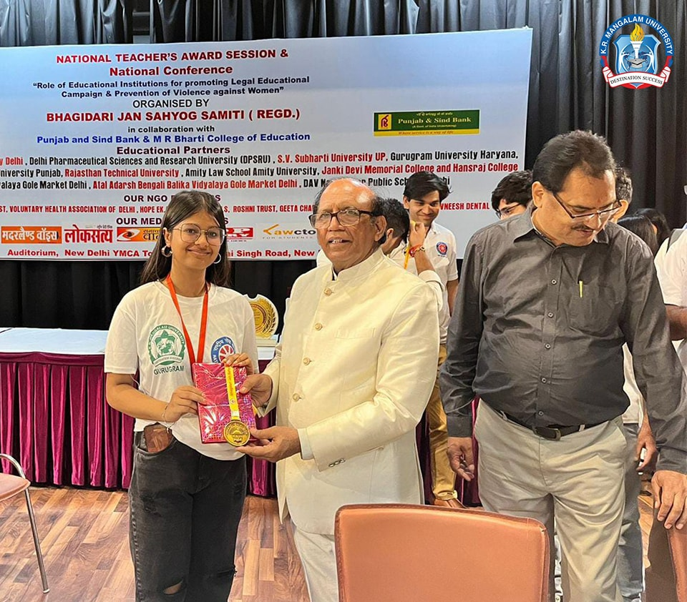
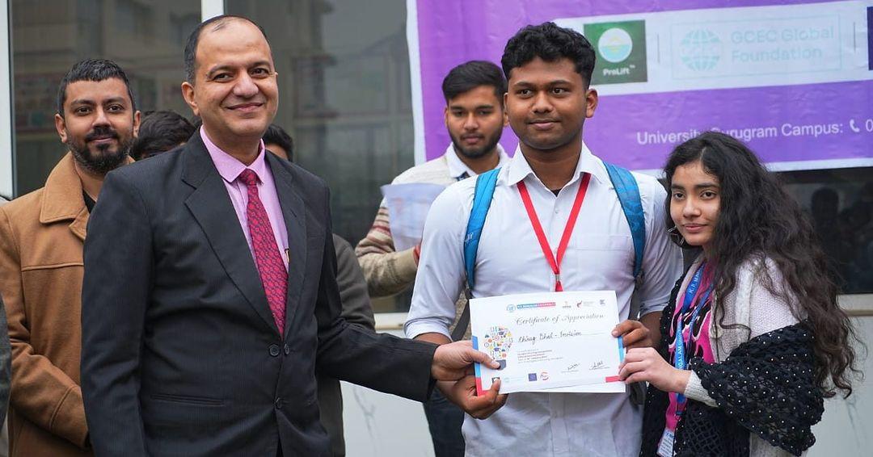
Outcome: Awards & Achievements by Students
243
2018-23
77
2023-24

Slide 17


